Slide 1

AASD 4004
Machine Learning - II
Applied AI Solutions Developer Program

Slide 2
Module 05 Topic Modeling
Vejey Gandyer

Slide 3
Agenda
Topic Modeling
LDA
Building a Topic Model

Slide 4
Topic Modeling
What is it?

Slide 5
Topic Modeling
Refers to the process of making sense of a collection of documents (corpus)
Splits / Groups a collection of documents into topics

Slide 6
Latent Dirichlet Allocation (LDA)
What is it?

Slide 7
LDA
Groups a collection of documents into "topics"
Input
Output
D1: I like to eat broccoli and bananas.​
D2: I ate a banana and salad for breakfast.​
D3: Puppies and kittens are cute.​
D4: My sister adopted a kitten yesterday.​
D5: Look at this cute hamster munching on a piece of broccoli.​
Topic A: 30% broccoli, 15% bananas, 10% breakfast, 10% munching
Topic B: 20% puppies, 20% kittens, 20% cute, 15% hamster
Document 1 and 2: 100% Topic A
Document 3 and 4: 100% Topic B
Document 5: 60% Topic A, 40% Topic B

Slide 8
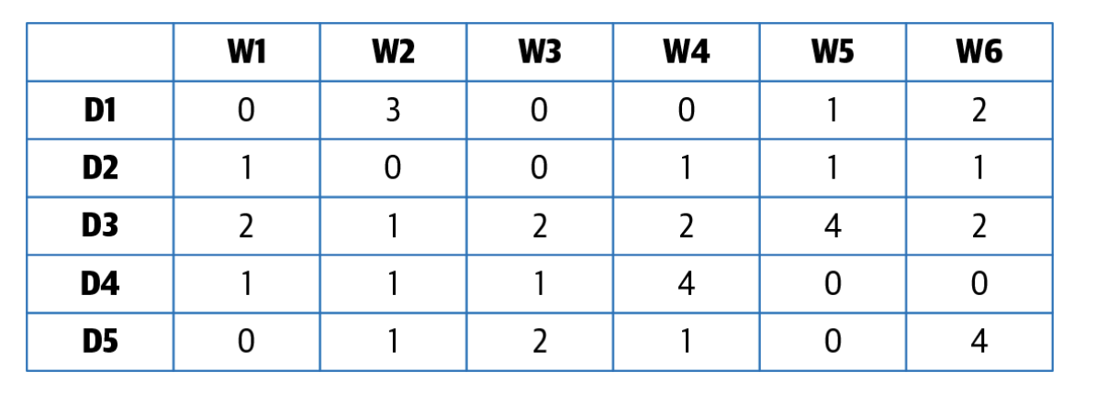
LDA
Document-Term Matrix (M)

Slide 9
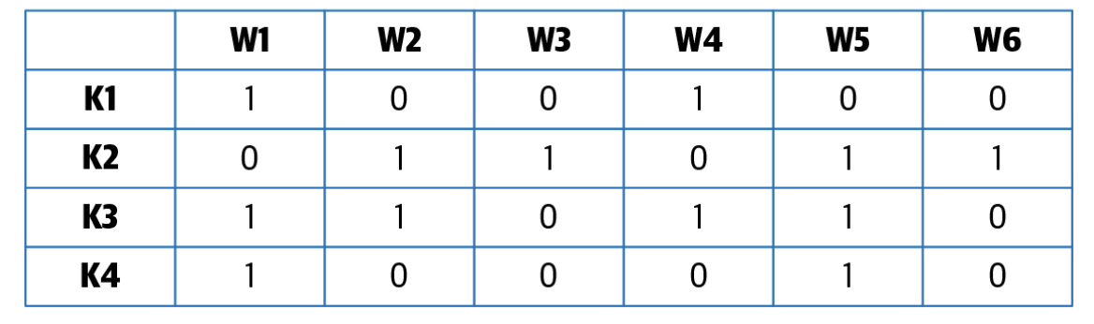
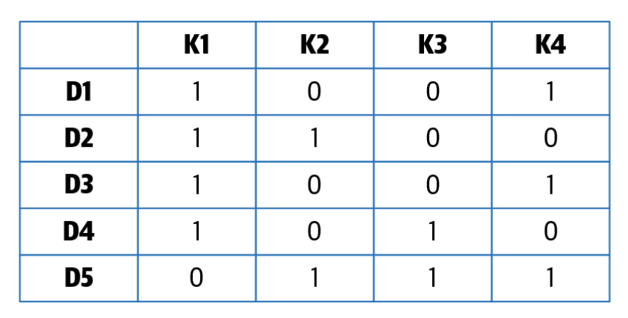
LDA - Factorization
Topics -Term Matrix (M2) K x N
Document-Topics Matrix (M1) M x K

Slide 10
LDA - Steps
Step 1: Import libraries
Step 2: Pre-process (Tokenize, remove stop-words, lowercase, …)
Step 3: Create a dictionary for the document
Step 4: Filter low frequency words
Step 5: Create a index to word dictionary
Step 6: Train the Topic Model

Slide 11
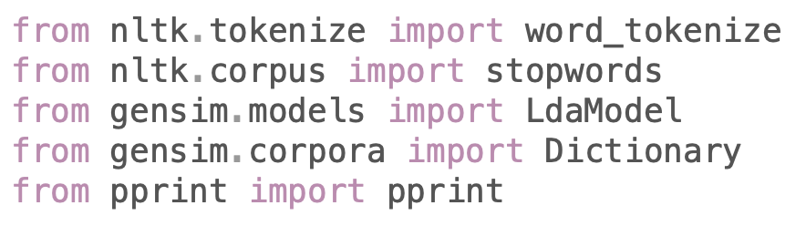
LDA - Importing libraries

Slide 12
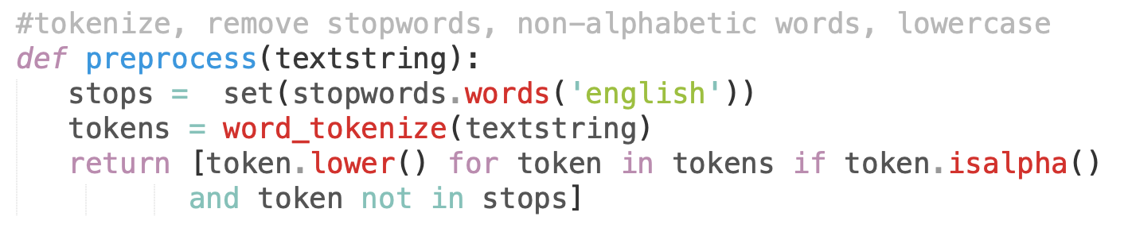
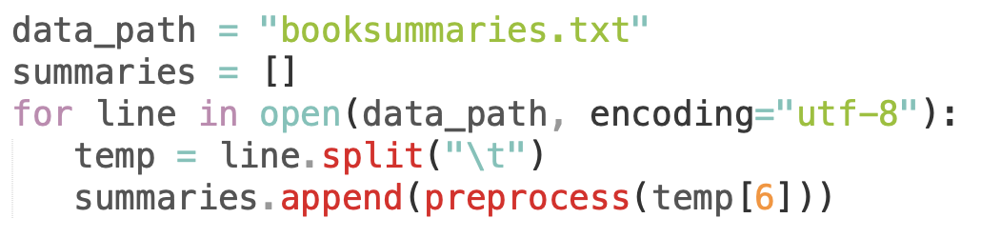
LDA - Pre-process

Slide 13
LDA - Creating a dictionary

Slide 14
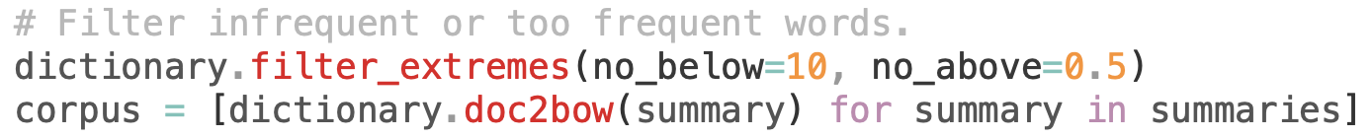
LDA - Filter low-frequency words

Slide 15
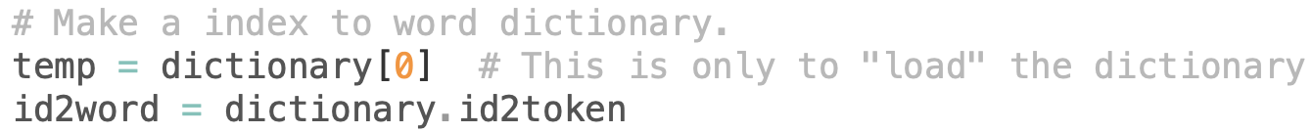
LDA - Index to word dictionary

Slide 16
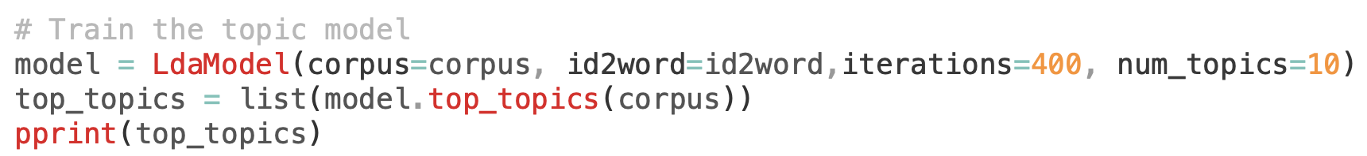
LDA - Train the Topic Model

Slide 17
Exercise: Building a Topic Model for the given dataset
https://raw.githubusercontent.com/subashgandyer/datasets/main/kaggledatasets.csv

Slide 18
Building a Topic Model
Create a Topic Model for a given dataset
- LDA

Slide 19
Further Reading
LDA
https://en.wikipedia.org/wiki/Latent_Dirichlet_allocation

